Slide 1
SAR time series:
Opportunities for AI applications
Dominique Derauw
dderauw@uliege.be
Murielle Kirkove
mkirkove@uliege.be

Slide 3
Earth Observation & Remote Sensing

Slide 4
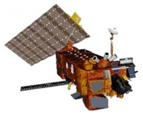
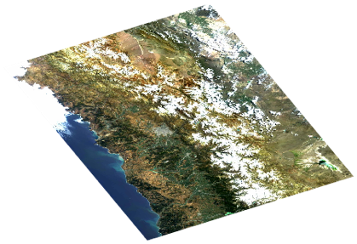
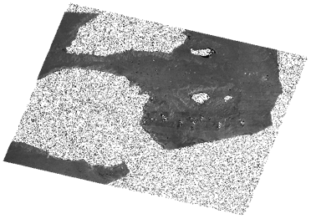
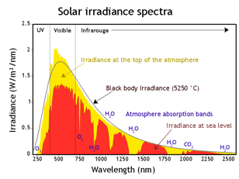
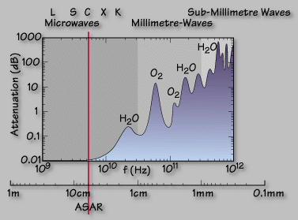
Remote Sensing
Passive sensor
Active sensor

Slide 5
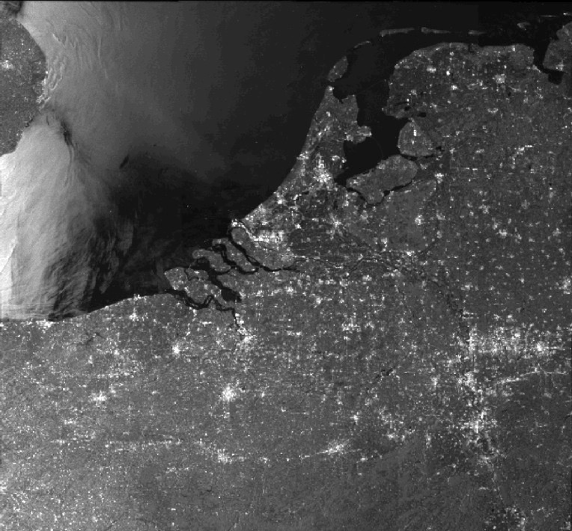
SAR Remote Sensing
Global coverage at repeated cycle
Insensitivity to external illumination
High sensitivity - large dynamic
Very large area coverage
Day and night (➫ X2)
Insensitivity (or nearly...) to cloud coverage ➫ All weather (➫ X5)

Slide 6
SAR focalization through AI?
SAR sensors are gathering signals along their orbit.
These signals must be focused to form an image
ESA opened project opportunities to study the feasibility of using AI to directly focus the image from the received signal.

Slide 7
SAR fine focusing through AI?
SAR focusing algorithmic mimics lens focusing
Whereas the name Synthetic Aperture Radar
Like optical systems, SAR focusing suffer from aberrations:
defocus, spherical aberration, coma, astigmatism, distortions, …
Approximations are made to speed up processing
Might AI help in improving focusing?

Slide 8
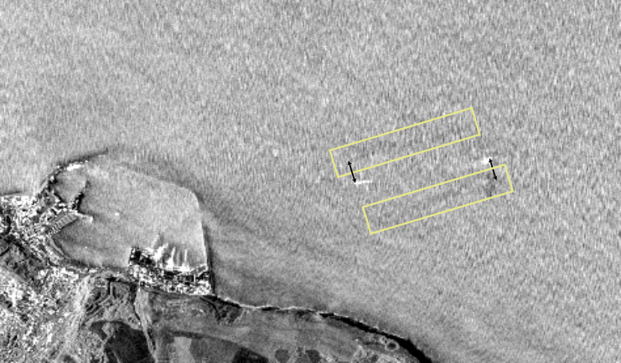
SAR specific focusing through AI?
SAR focusing algorithmic considers stationary scene.
Moving targets are focused out of instantaneous location.
Shift is proportional to speed.
Inverse SAR methods allows focusing moving targets
Might AI help in detecting and characterizing moving targets?

Slide 9
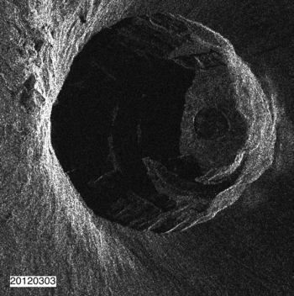
SAR images time series
Nowadays profusion of data allows forming time series:
Spatiotemporal analysis are possible.
Example of Nyiragongo lava lake leveling.
Might AI help in detecting time changes?

Slide 10
SAR images time series
Nowadays profusion of data allows forming time series:
Spatiotemporal analysis are possible.
Flanders 2016 - 2022
Might AI help in detecting,
classifying, identifying changes?

Slide 11
SAR images time series
Spatiotemporal analysis are possible.
Classical statistics
Standard deviation
Flanders 2016 - 2022
Might AI help in detecting,
classifying, identifying changes?

Slide 12
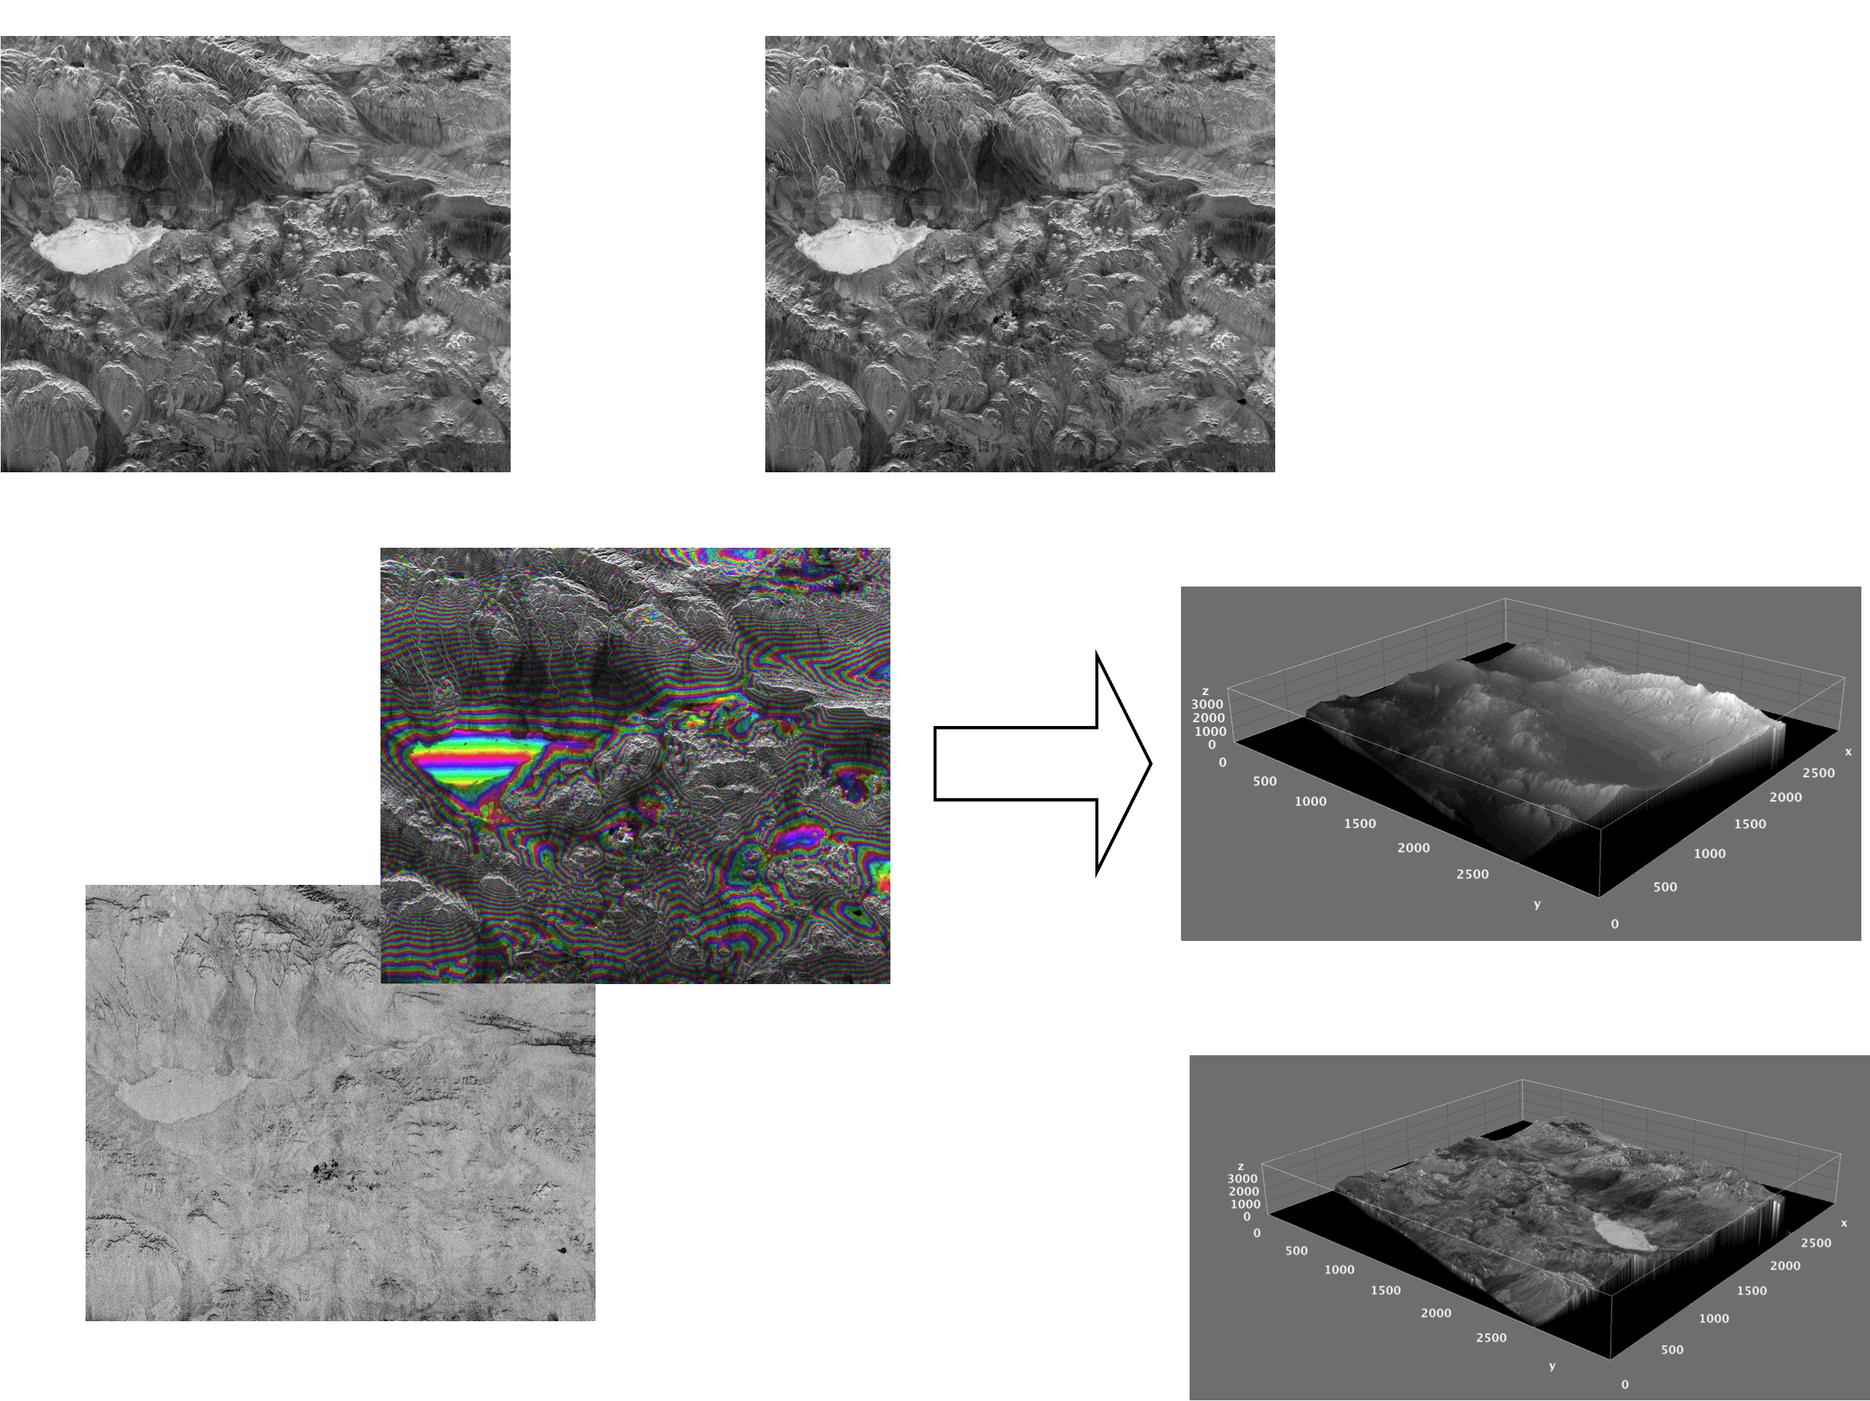
SAR interferometry

Slide 13
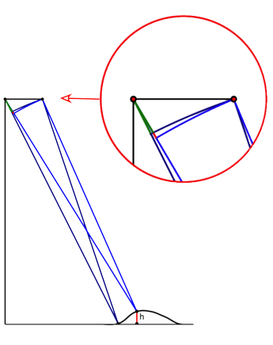
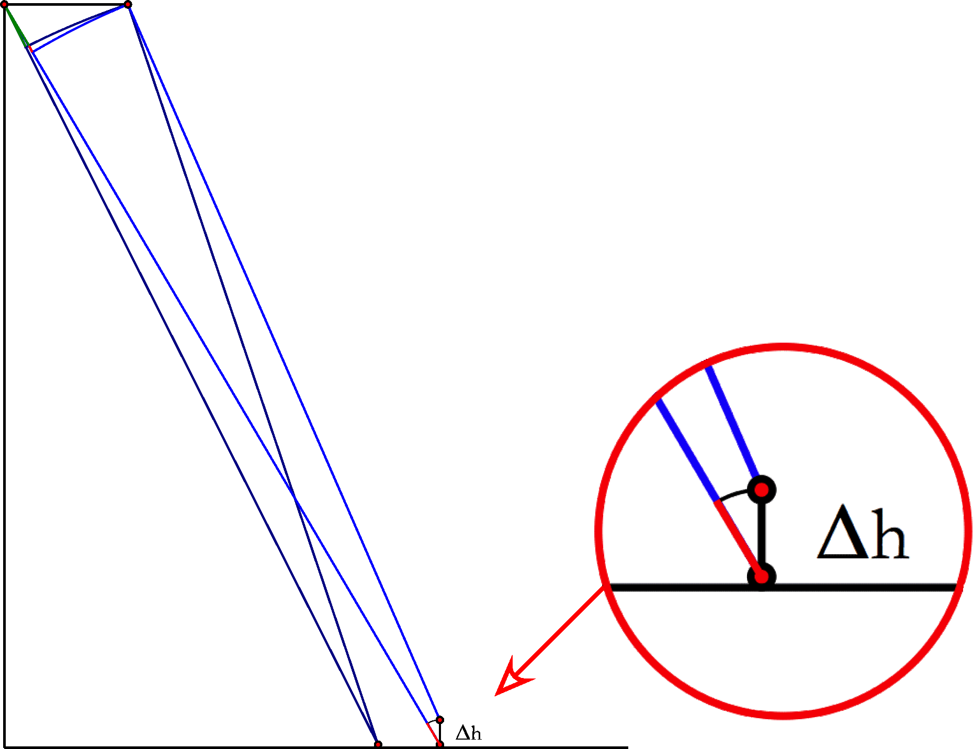
SAR interferometry
The interferometric phase contains:
The orbital phase
The topographic phase
The atmospheric phase delay
The displacements phase
Noise

Slide 14
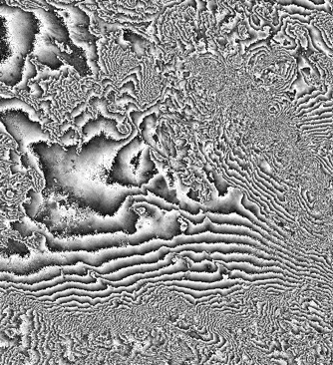
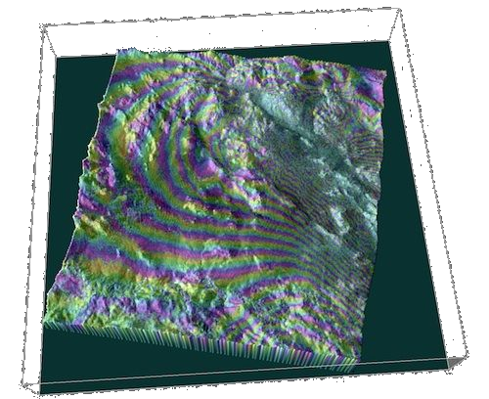
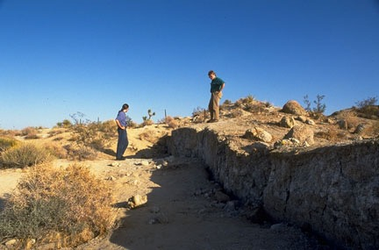
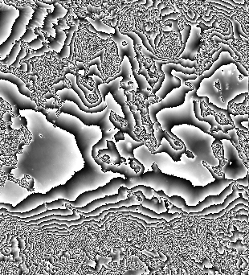
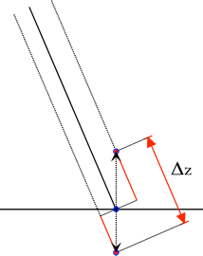
SAR differential interferometry - DInSAR
© "Robert A. Eplett/CAL EMA"
California Governor's Office of Emergency Services
Landers earthquake - 1992
Might AI help in phase unwrapping?

Slide 15
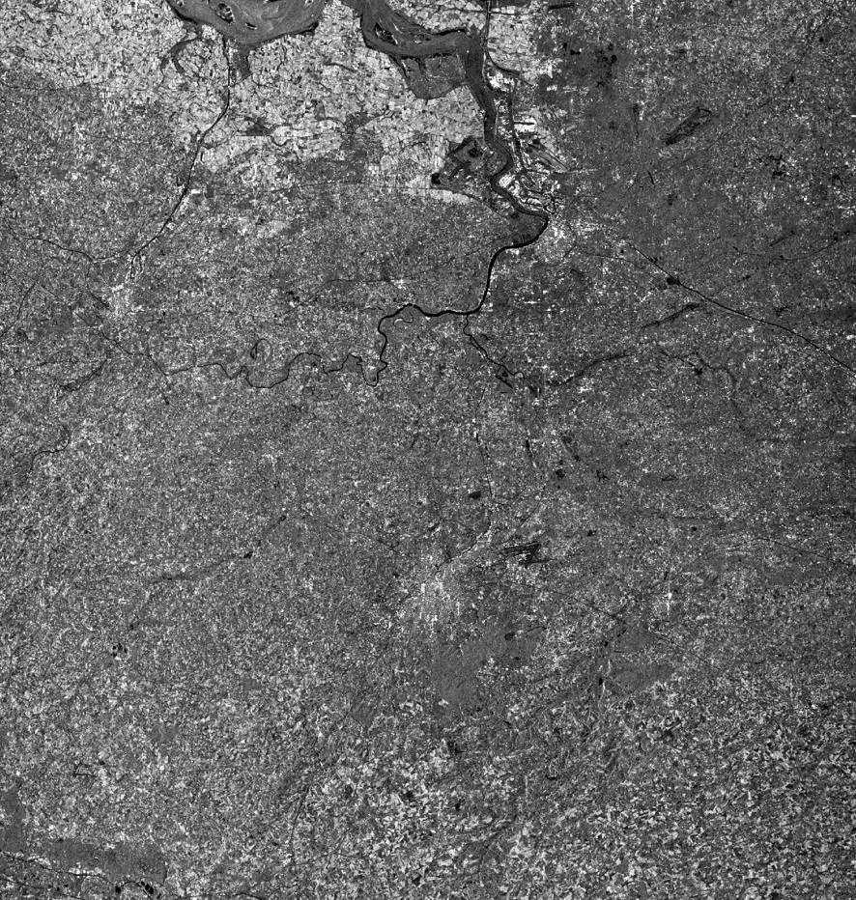
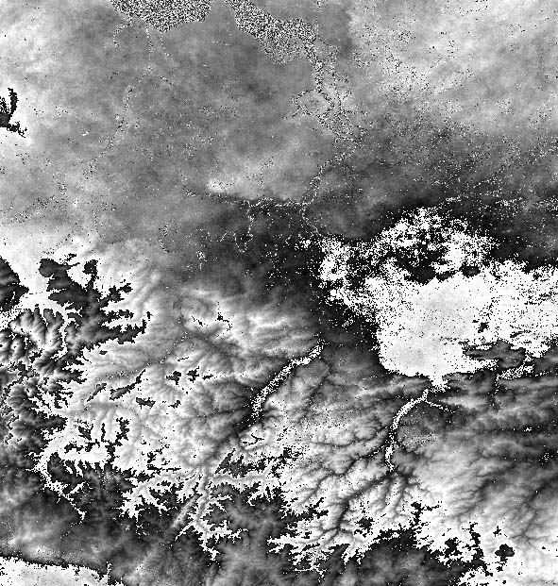
InSAR atmospheric perturbations
Belgium, April 1996
ERS amplitude image

Slide 16
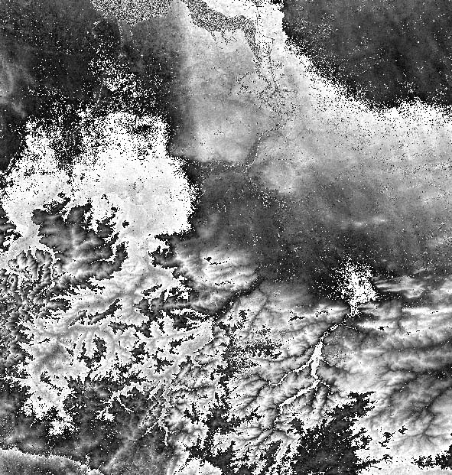
InSAR atmospheric perturbations
Might AI help in segmenting topographic from atmospheric signal?
Interferogram with
Atmospheric perturbation

Slide 17
DInSAR time series
DInSAR gives a « one-shot » view of observable displacements
Post-seismic measurements
To observe long-term displacements, one can use time-series and combine DInSAR measurement sequences:
MSBAS

Slide 18
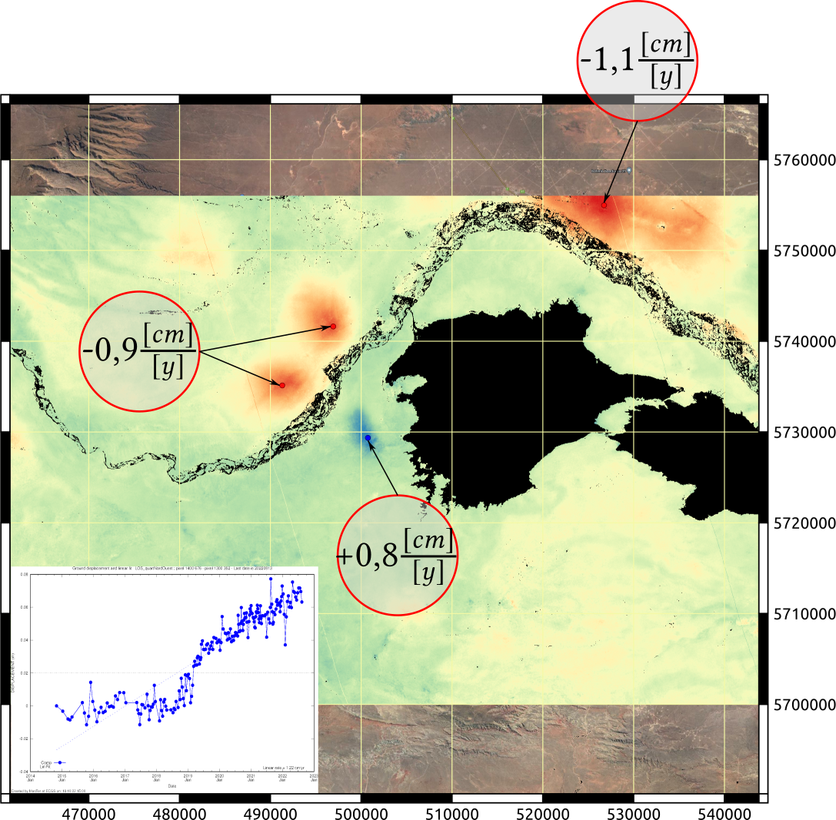
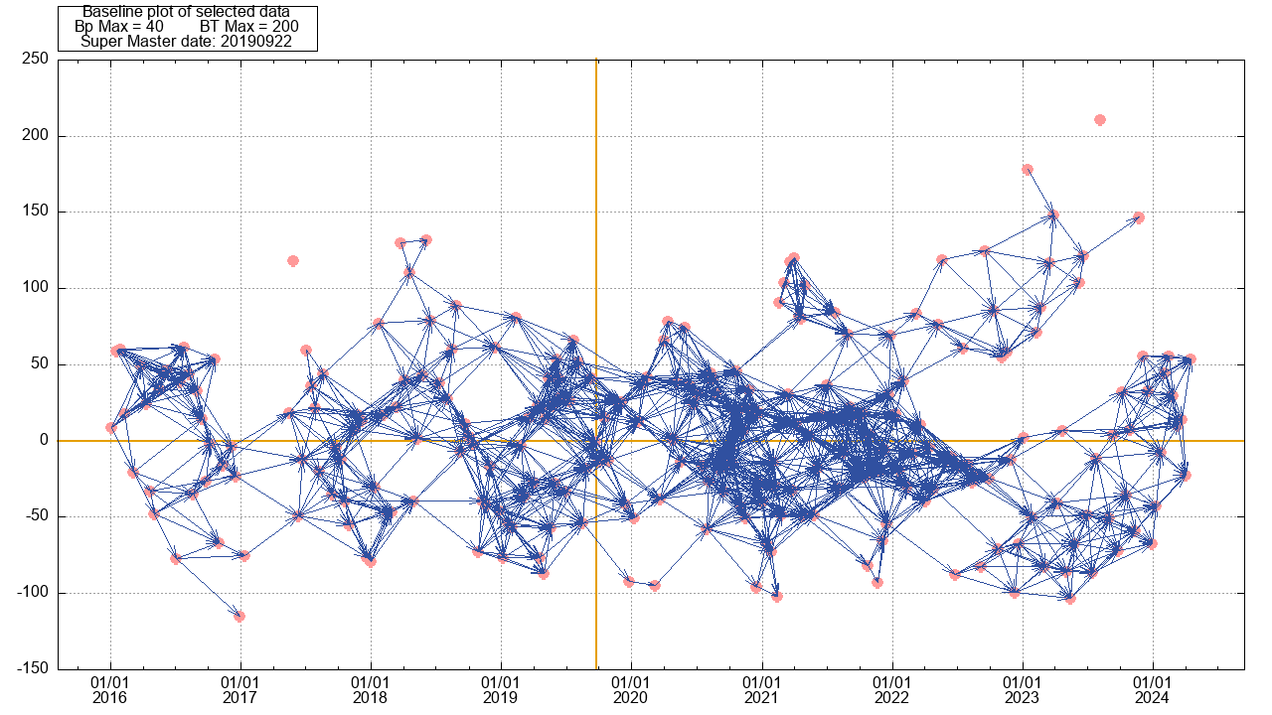
DInSAR time series
Might AI help in pair selection?

Slide 19
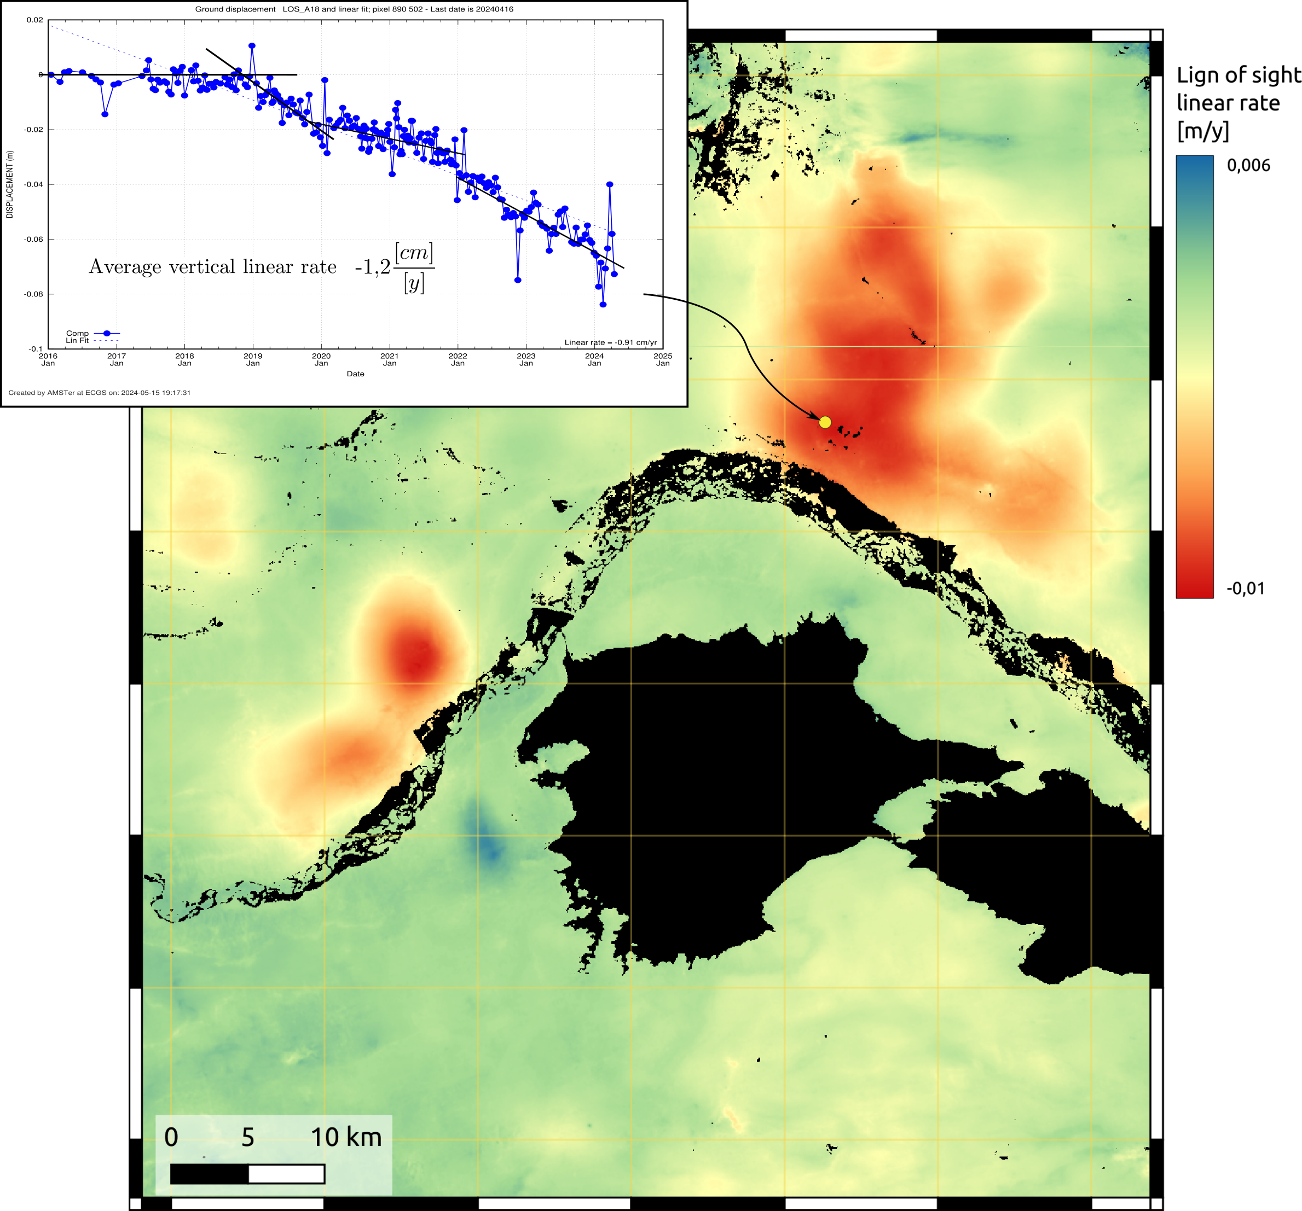
DInSAR time series
Might AI help in extracting displacements
from InSAR time series?

Slide 20
Conclusion
?

