Slide 1
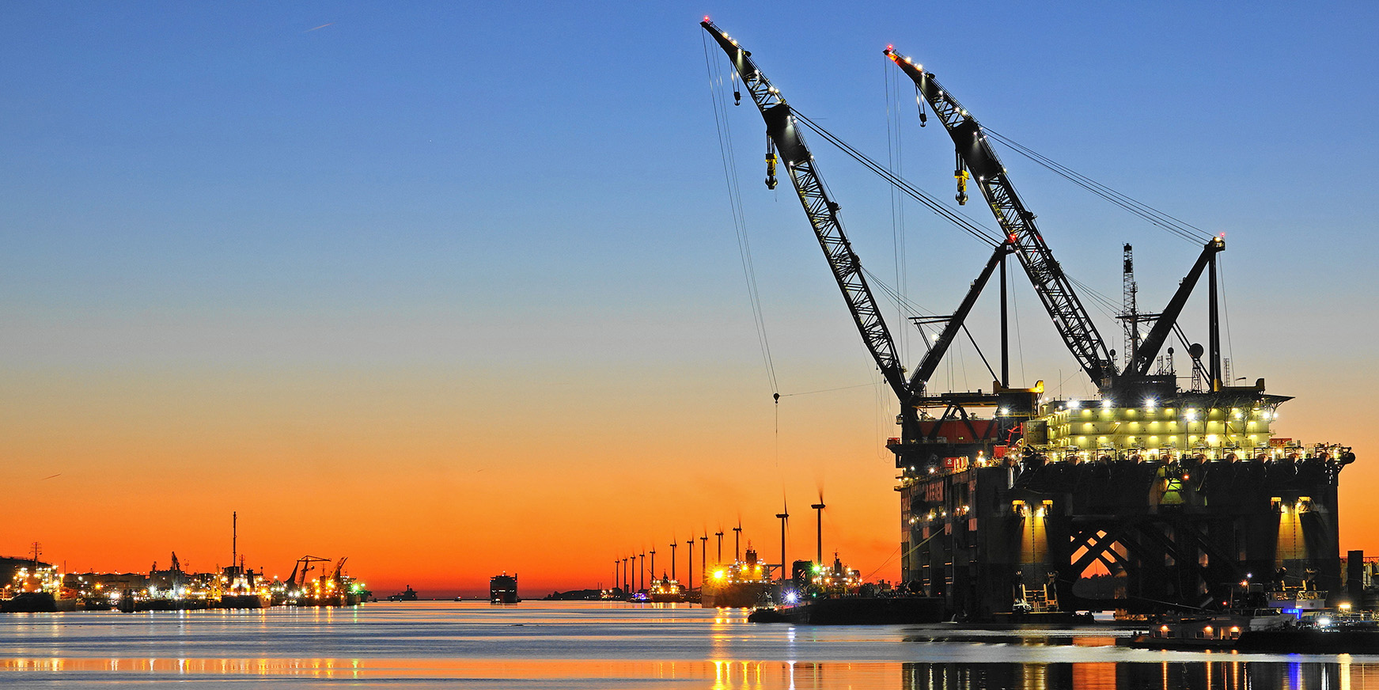
Deformation Measurements by SatelLite
Vincent Langelaan
Asset Management Constructions & Dredging

Slide 2
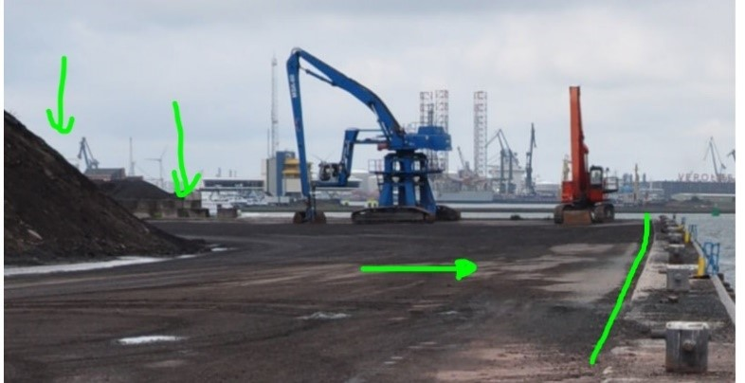
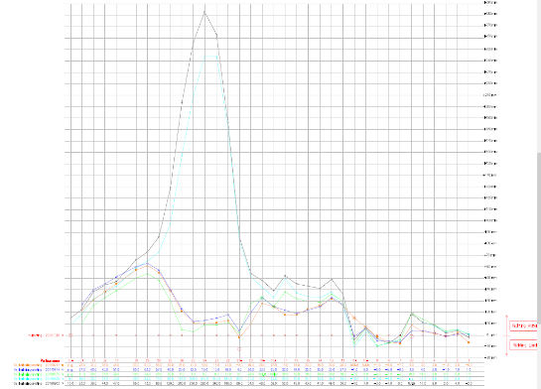
Why do we measure?
The Port of Rotterdam has been collecting deformation measurement data on its quay walls, jetties and structures by means of Tachymetry since the 1970s.
These deformation measurements provide insight into the condition of the objects; are they still in place geographically (X,Y,Z).
In this way we cover a risk: deviations/displacement can be an indicator of uneven settlement, damage and/or overload. The occurrence of these risks leads to higher (repair) costs and/or claims.
The more often we measure, the sooner we can identify possible deviations and the sooner we can take counter actions.

Slide 3
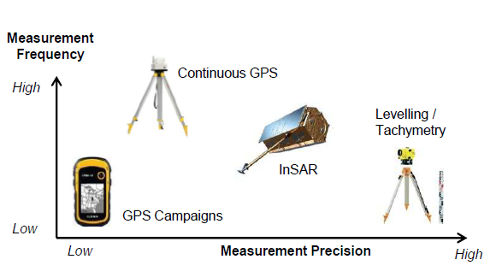
Productmix
In the opinion of the Asset Management Constructions & Dredging department, risks can be most effectively mitigated with a mix of measurement methods/products;
Satellite,
Traditiona / Tachymetry and
Sensor
Each method has its advantages and disadvantages in the form of customer inconvenience, frequency, costs, etc.
Within the department, based on the risks of an object or user, we choose a measurement method that ultimately results in the optimal use of resources.

Slide 4
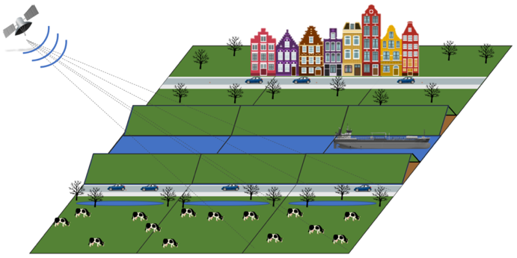
Radar satellite measurements
Reflections depend on surface characteristics
Good measurements on solid, angular objects
(e.g. urban areas, solid rock)

Slide 5
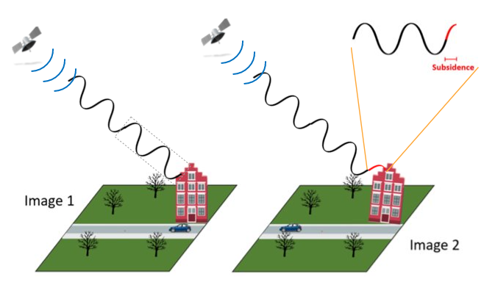
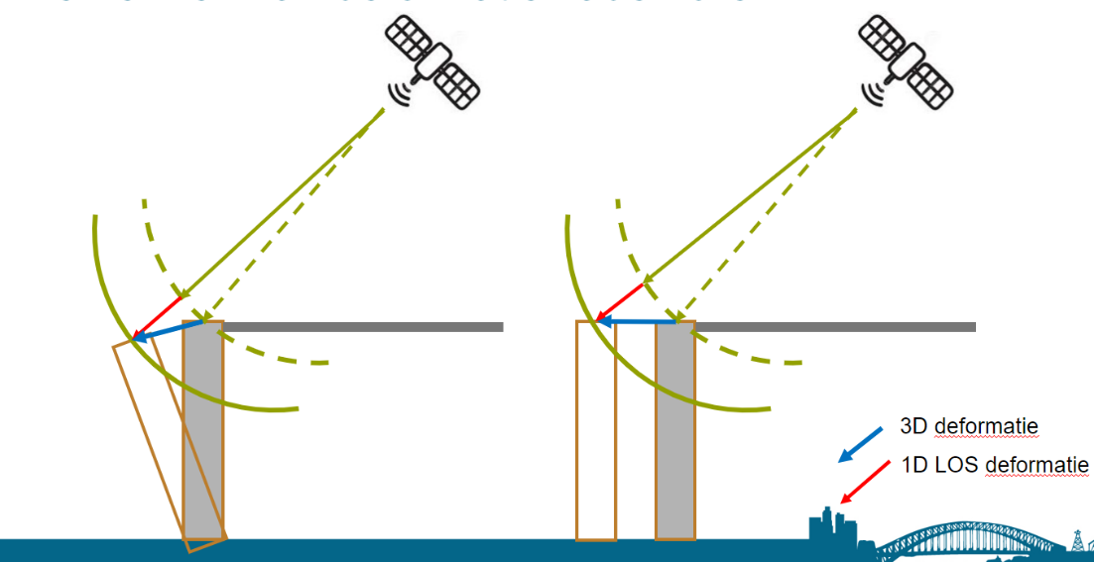
Satelliet – measurements from space
Surface deformations mean a change in signal travel time
By using the phase, InSAR can determine
this with mm-level precision
Doing this for a stack of images over time,
you can create deformation time series
But…….
Does it also work on quay walls & jetties

Slide 6
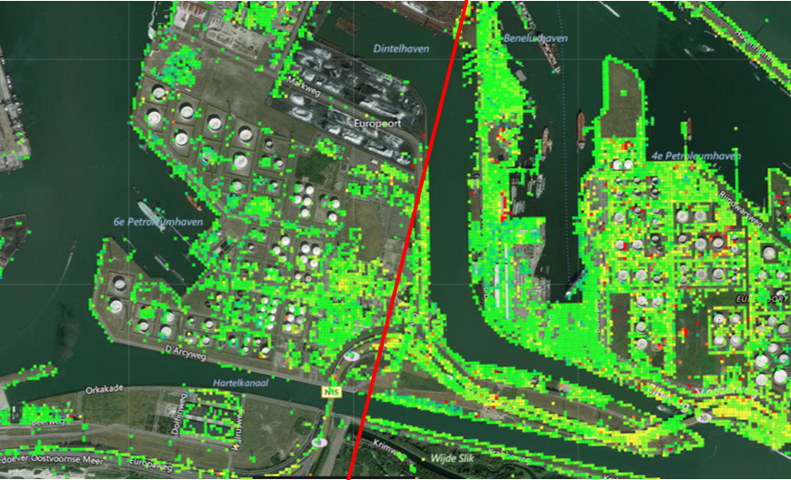
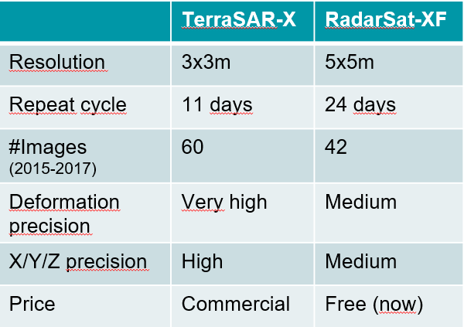
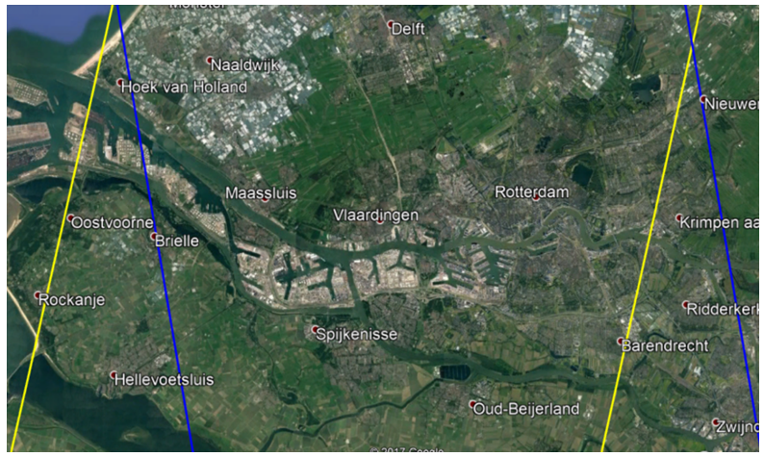
TerraSAR-X vs Radarsat-XF
DSC
ASC

Slide 7
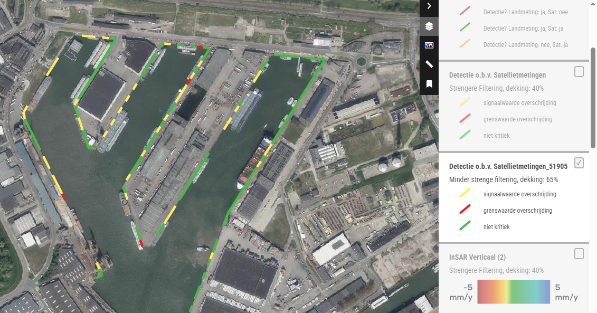
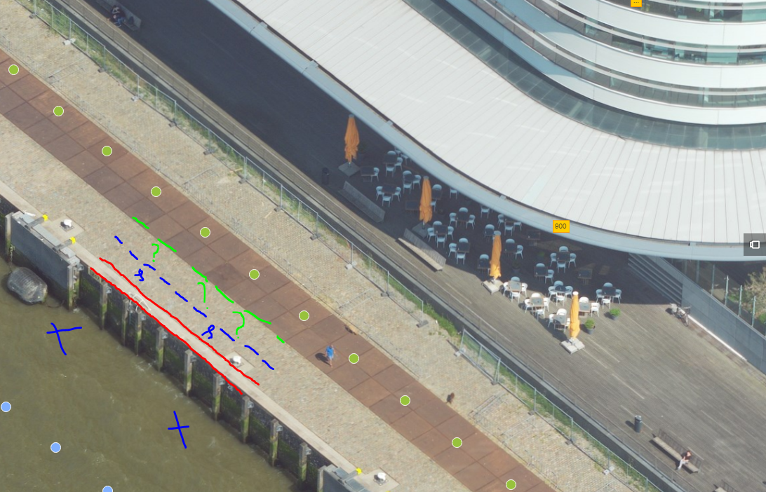
Settings
Filter
65%

Slide 8
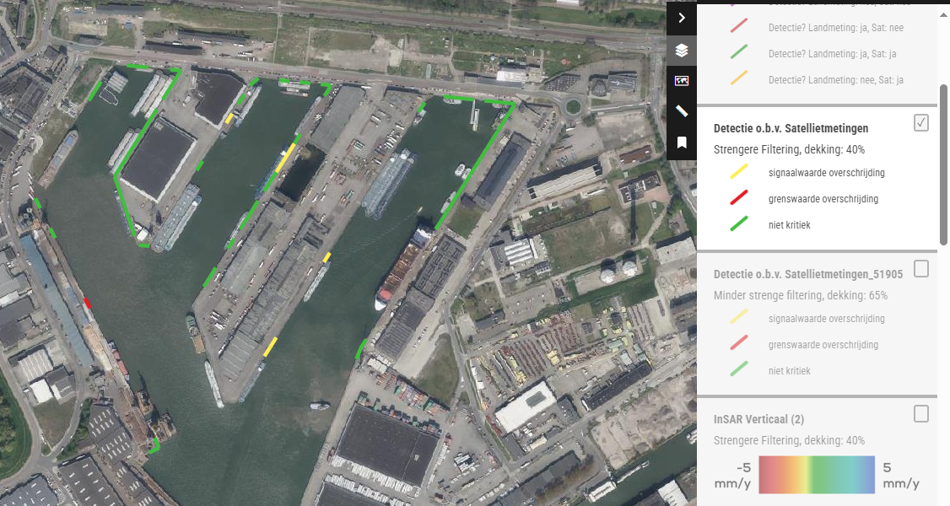
Settings
Filter
40%

Slide 9
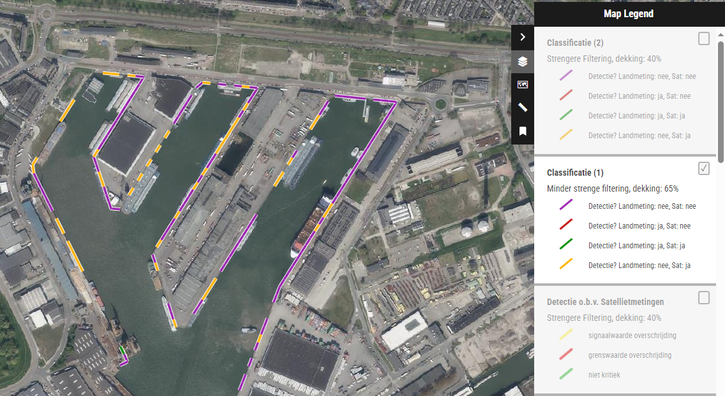
Validation
Filter
65%

Slide 10
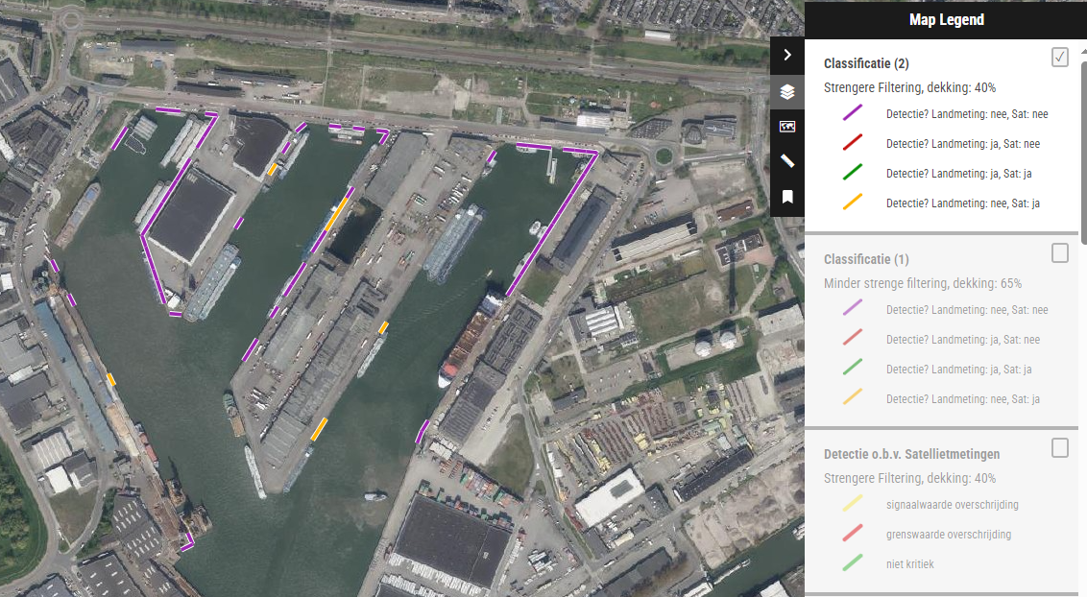
Validation
Filter
40%

Slide 11
InSAR (DIS)advantages
          Disadvantage
          Not all objects ‘visible’ for XYZ
          No complete coverage per object
            East – West is more difficult than North South
            Cranes
            Ships
          Advantages
          Displacement on mm level
          Low cost per measurement point, large coverage
          Dataset available starting 2017 (XYZ)
          Looking back in time ( Z as of 1992 possible)
          Every 11 till 22 days
          Without customer nuisance

Slide 12
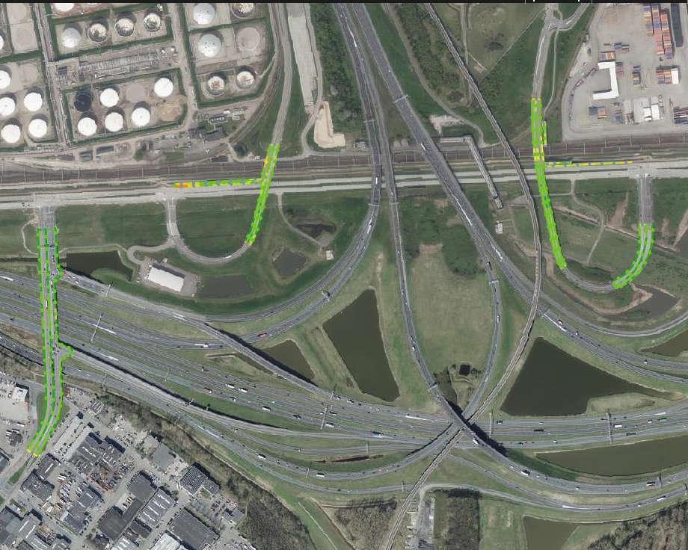
Overpasses
- No temporary traffic arrangements needed
- Nothing blocks the signal

Slide 13
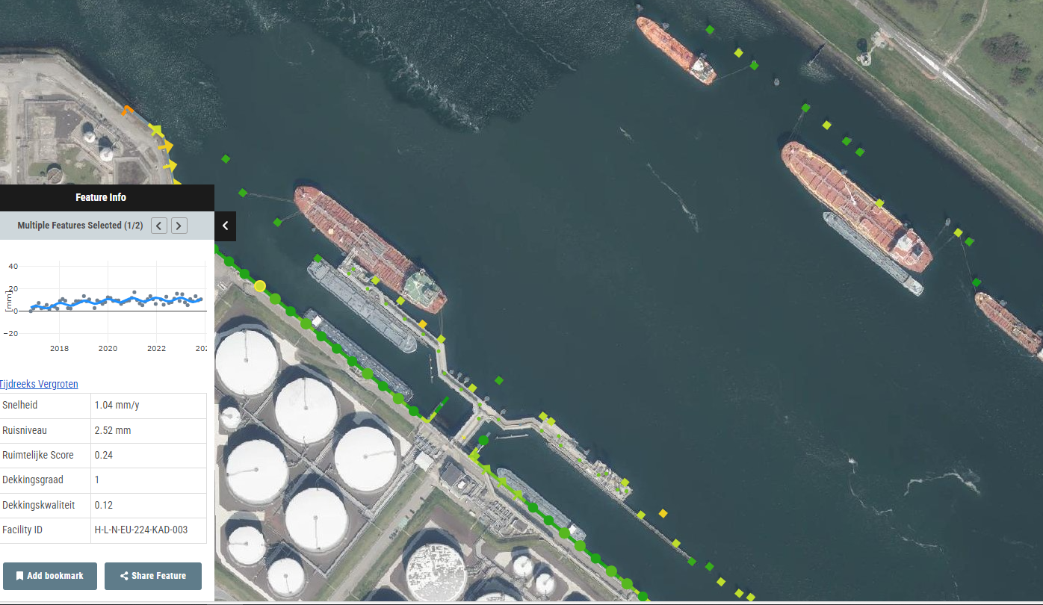
Quay Walls & JEtties
And also Dolphins and roads.
We never did measurements there, but the satellite is non selective

Slide 14
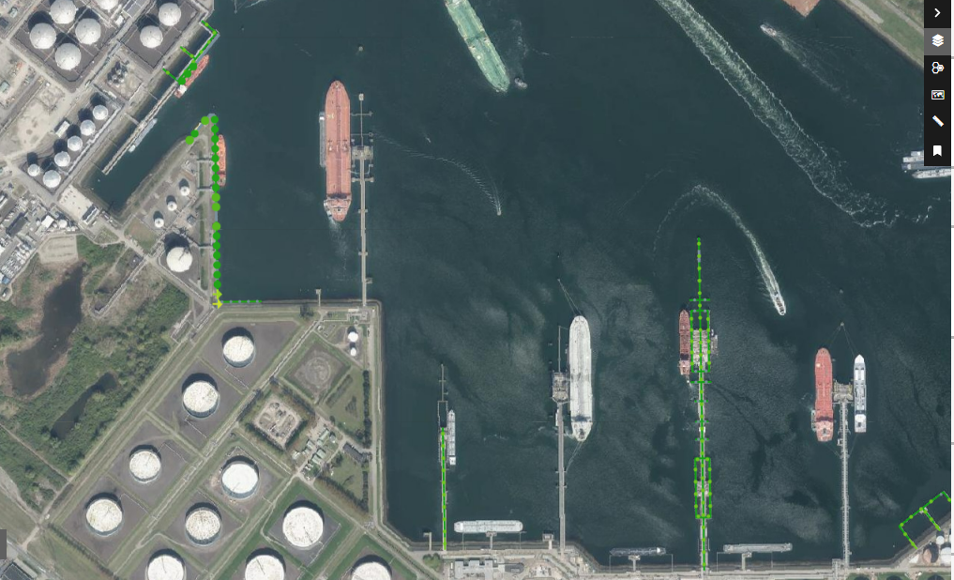
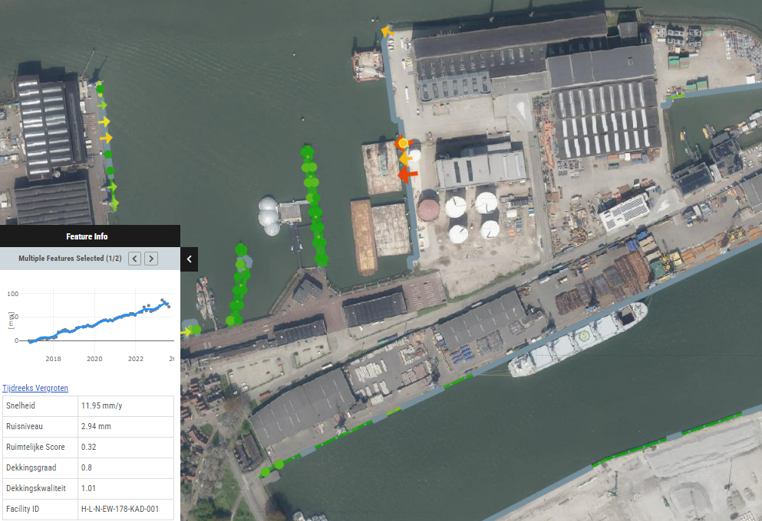
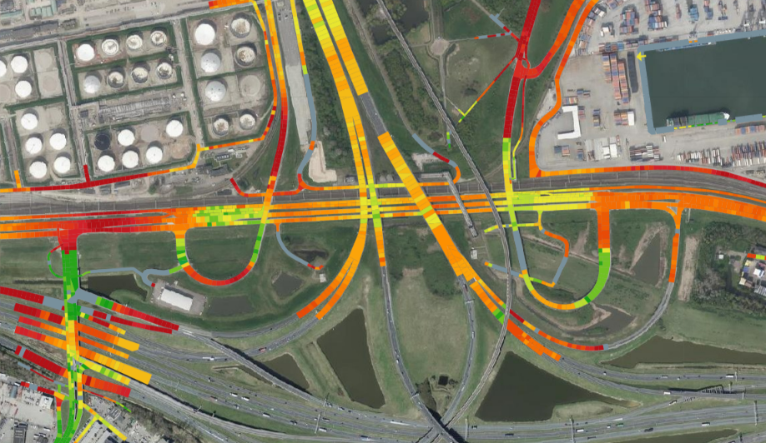
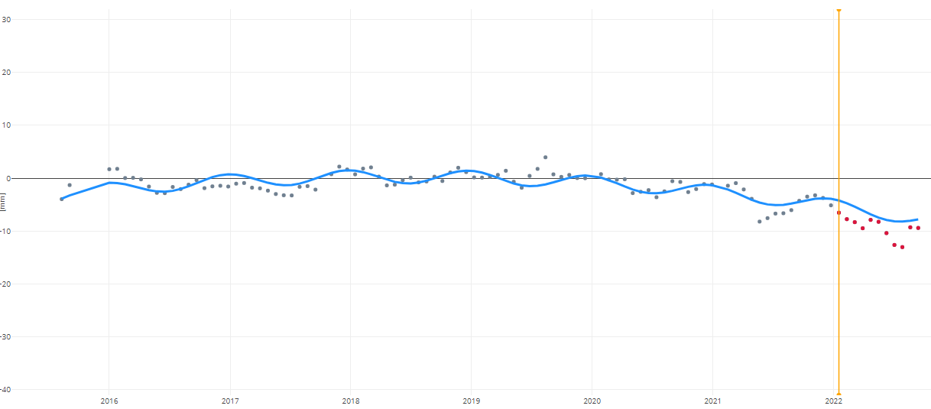

How do we use the info?

Slide 15
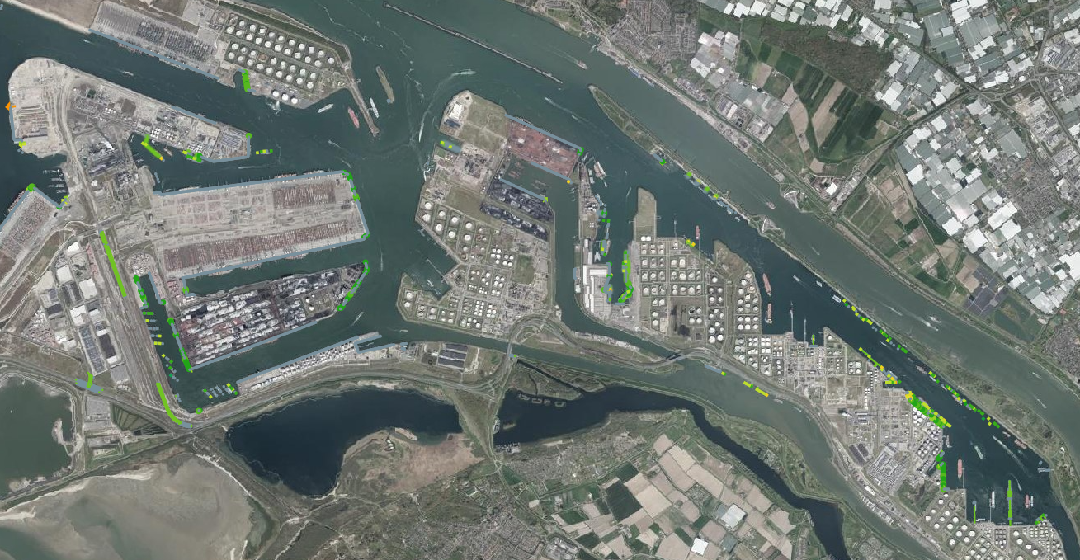
Overview
The satellite plays an important role in the productmix. The first global indication of movement.
Works well and is competitive on ‘land based’ assets.
Has some problems with objects (cranes, ships) and orientation on maritime infrastructure, but helps to ‘guide’ other methods from the mix.
Generates information on assets we never had and need to explore

