Slide 1
Satellite based right-of-way inspections
Gasunie & Orbital Eye
Bas Schoonbeek - Gasunie
Jelle Mol – Orbital Eye

Slide 3
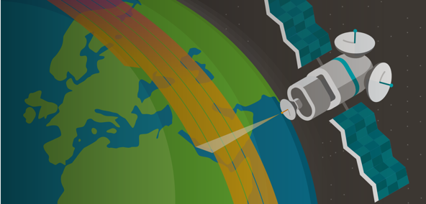
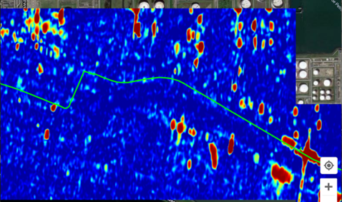
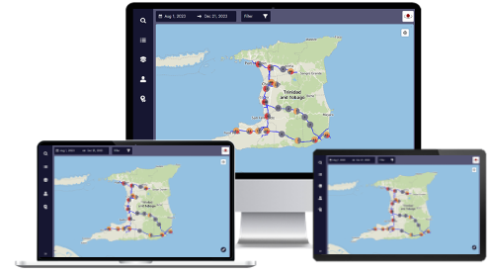
COSMIC-EYE: How it works
Collect satellite data for corridor
AI-assisted data analysis
Easy-to-use application
Weather Independent Radar
Multispectral
High-Resolution Optical
Analysis of satellite data to detect Third Party Interferences
Irrelevant activities are filtered out
TPIs are reported in the web-based COSMIC-EYE app
Along with optical images for location of interest

Slide 4
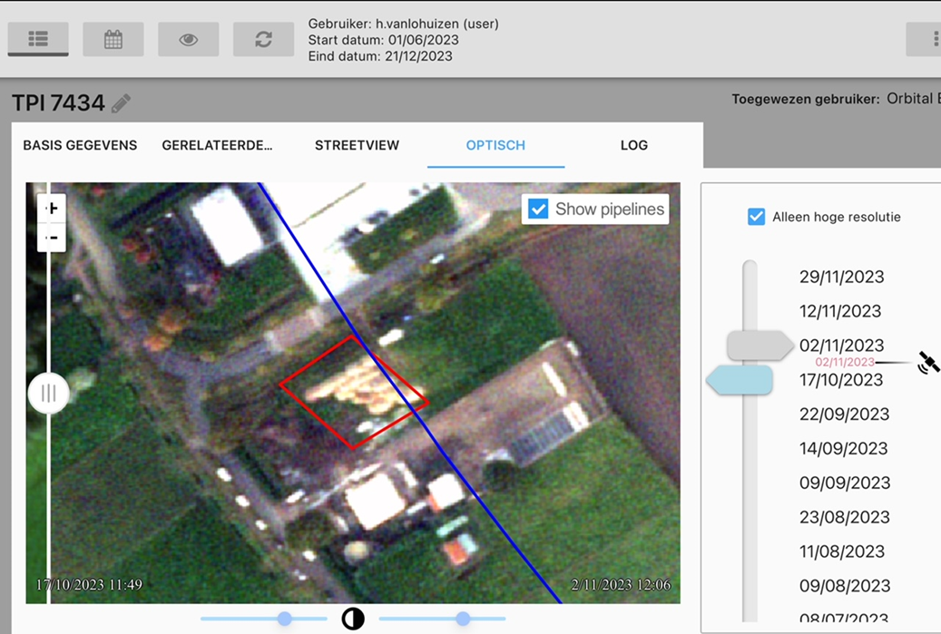
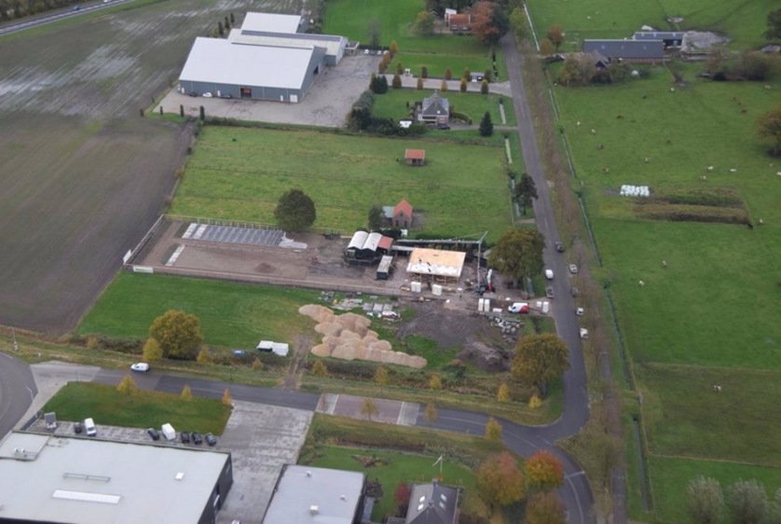
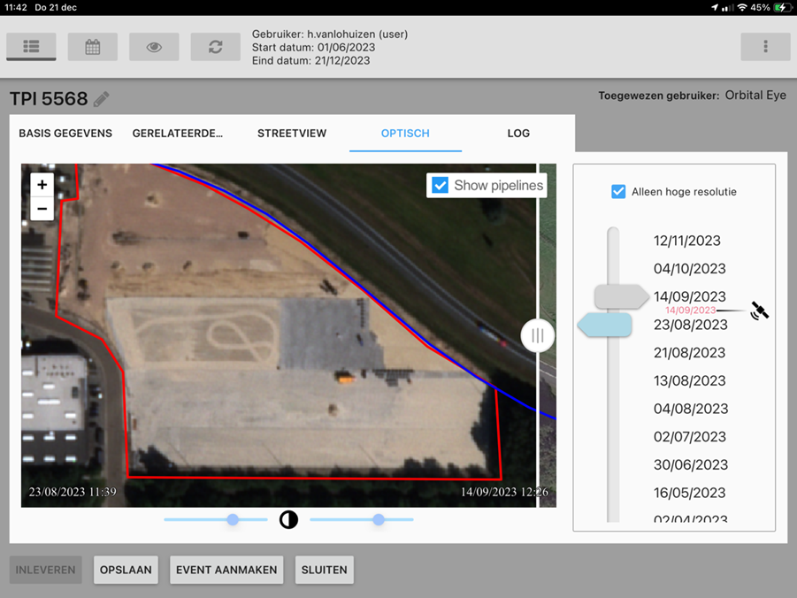
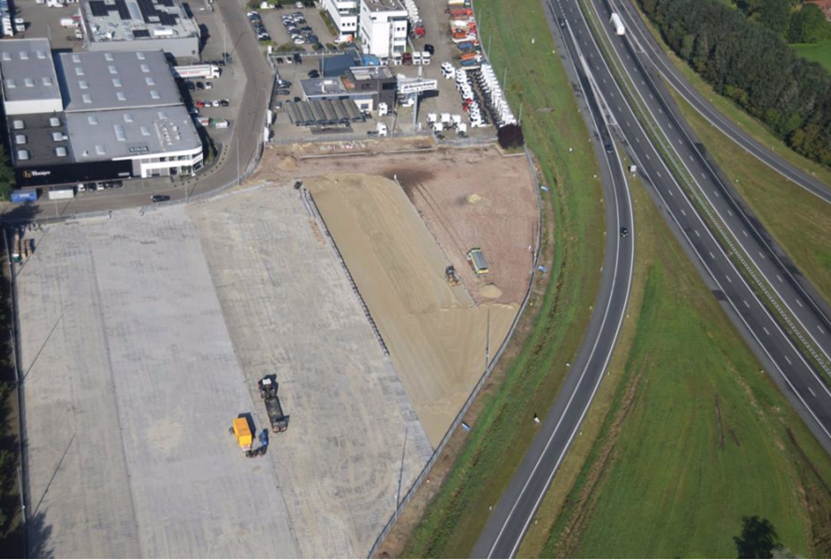
#4

Slide 5
COSMIC-EYE for Gasunie - results
Area | The Hague | Terneuzen | Twente
Number of TPIs | 1015 | 239 | 441
Relevance of activities: Relevant activity Non-relevant activity
Comparison with helicopter: Detection capability
Comparison with helicopter: Moment of detection
Only helicopter
Only COSMIC-EYE
Both
35%
25%
35%
Helicopter first
COSMIC-EYE first
65%
75%
65%
Notes:
Add type of area

Slide 6
Orbital Eye x Gasunie: Conclusions in a nutshell
Pipeline Technology Conference 2024 - paper
Quicker detection
Broader scope of detection
Good working relationship
Exact location
High potential:
Use-cases
Improvement in detection
Not all Helicopter pictures were picked up
Time it takes for Gasunie personel to get acquinted with COSMIC-EYE
Direct action on risks
Presence in the sky
Optical image quality

